Slide 1
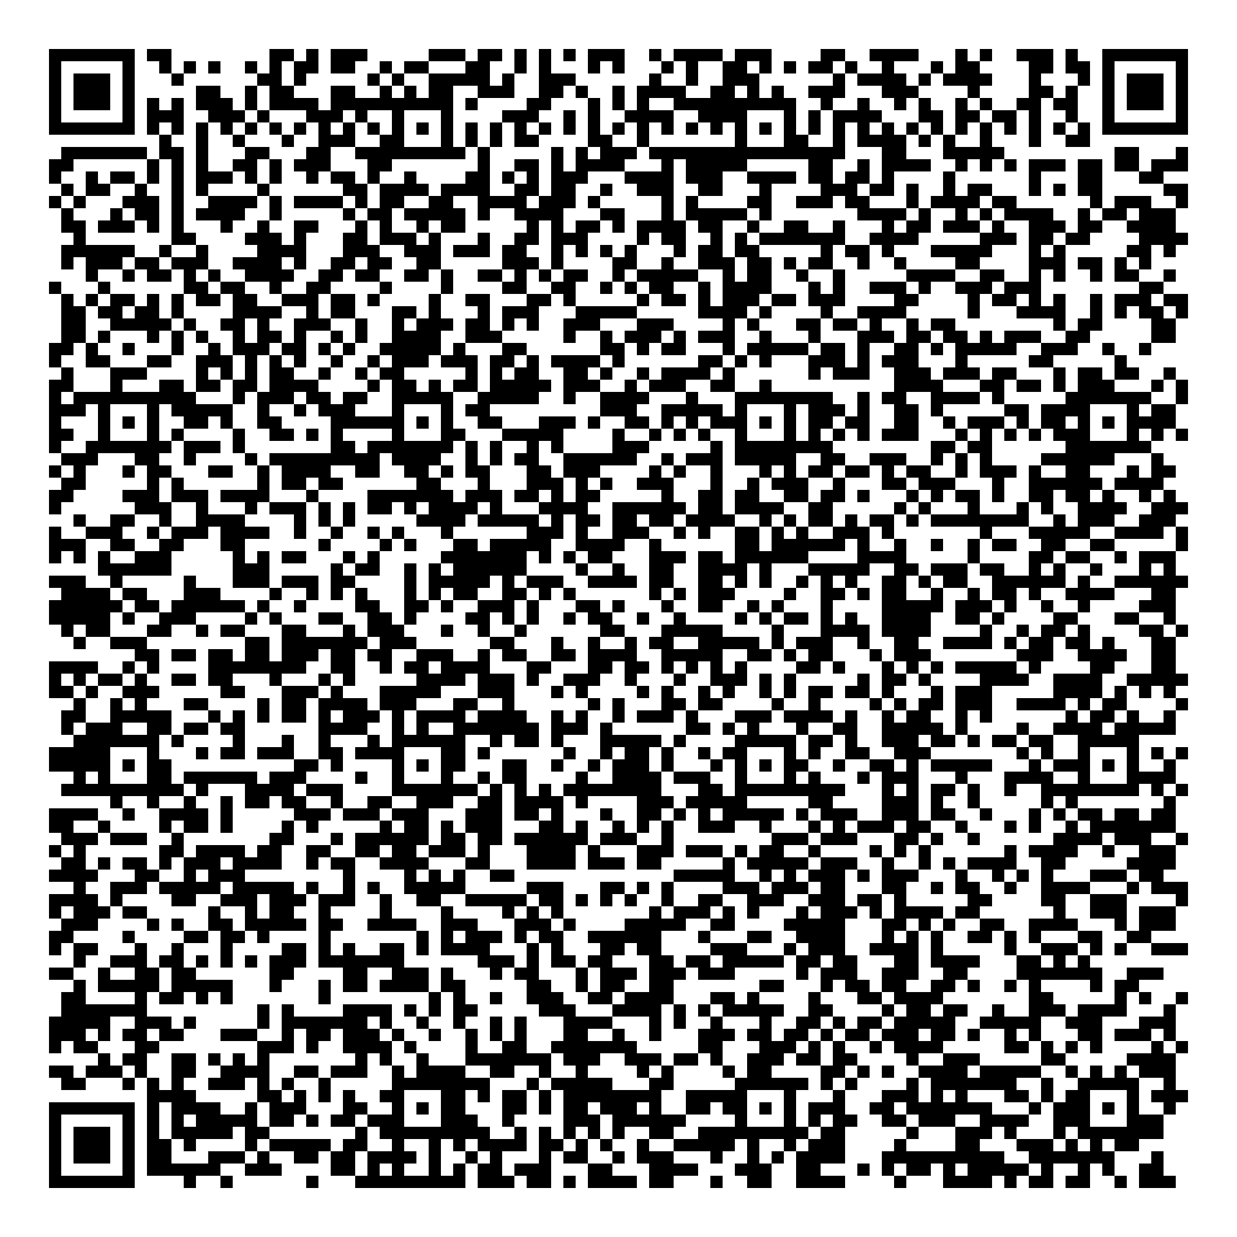
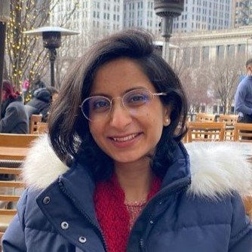
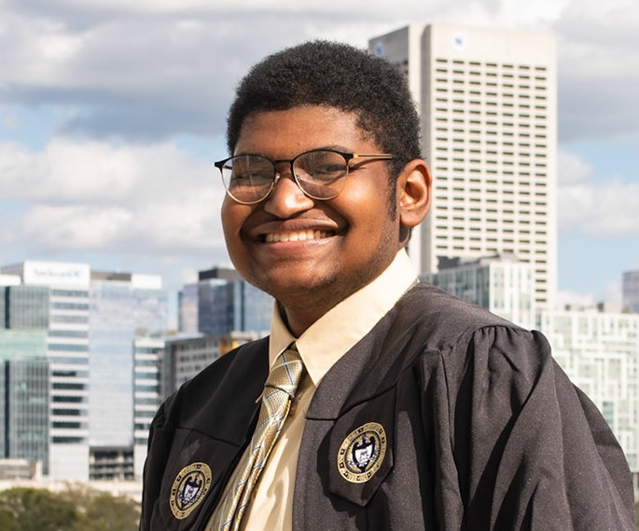
Mastering the Chaos: Organize your Research like a Pro
Scan to log attendance
Featuring:
Mehdia N. Rajab Ali
Anthony Compton
Research Insights Club

Slide 2
Our Purpose
(1) To disseminate detailed and hard-to-obtain knowledge to Georgia Tech students to help them navigate and thrive in the complex field of academic research.
(2) To facilitate knowledge transfer and networking between student researchers outside their usual fields.
Insights
Implementation Strategy
Research Insights Club
Faculty seminars
How to read papers efficiently
Useful research tools
Student panels
Presentation skills
Networking
Applying for fellowships
Teams channel
Project organization
File management
Outreach events
Tips for mentoring undergrads
Blog

Slide 3
Join us!
Students & researchers at all levels welcome
If interested, reach out to Steven Swingle → steven.swingle@gatech.edu
Find us on Engage https://gatech.campuslabs.com/engage/
Follow us on instagram @gatech.ric

Slide 4
Mastering the Chaos: Organize your Research like a Pro

Slide 5
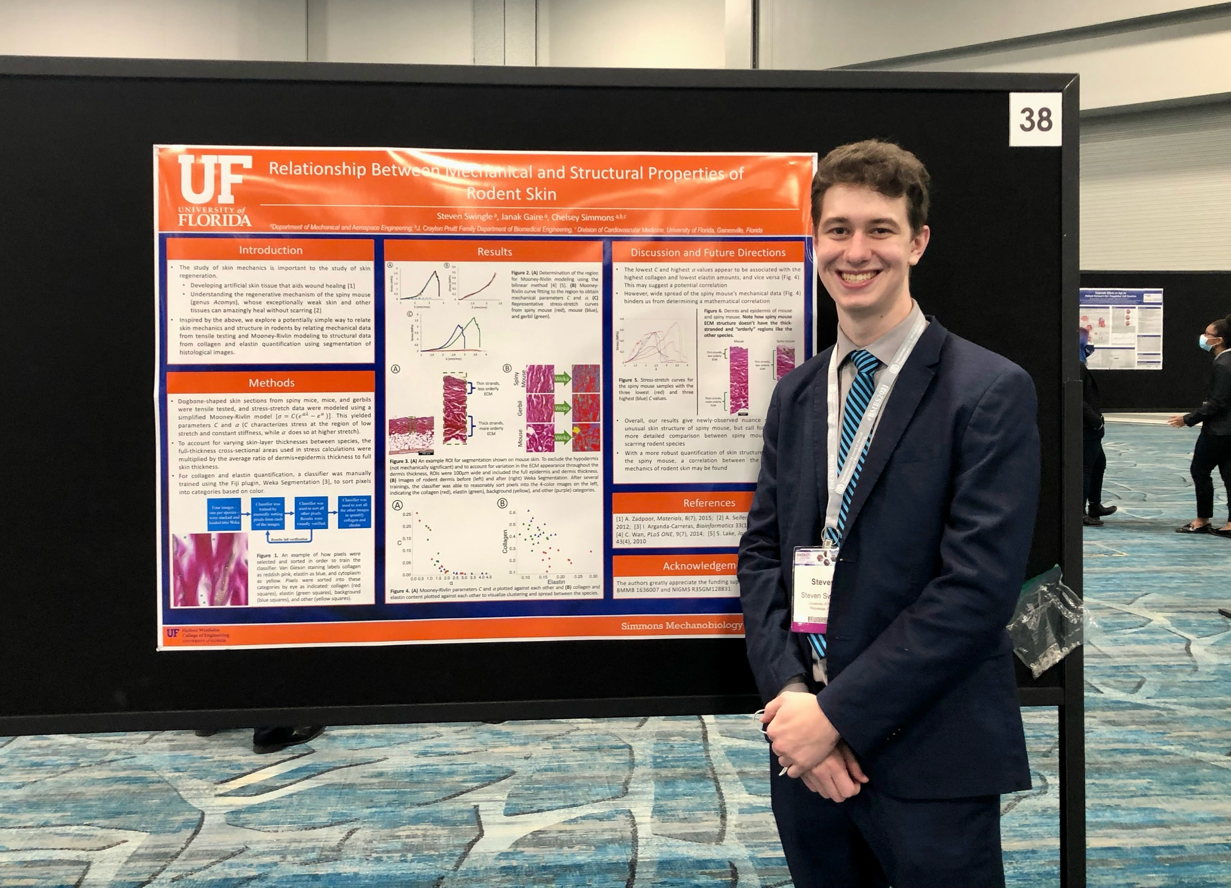
Why is organizing your research important?
Stressed
Sporadic
Unfocused
Not organizing what I was doing
Research protocols
Goals
Papers
Network
Steven, circa 2021
Notes:
Stressed
No clear vision - sporadic thoughts/goals
Trying things out, not recording what I was doing well
- Would try to repeat, but I wasn’t documenting correctly
Balance with classes

Slide 6
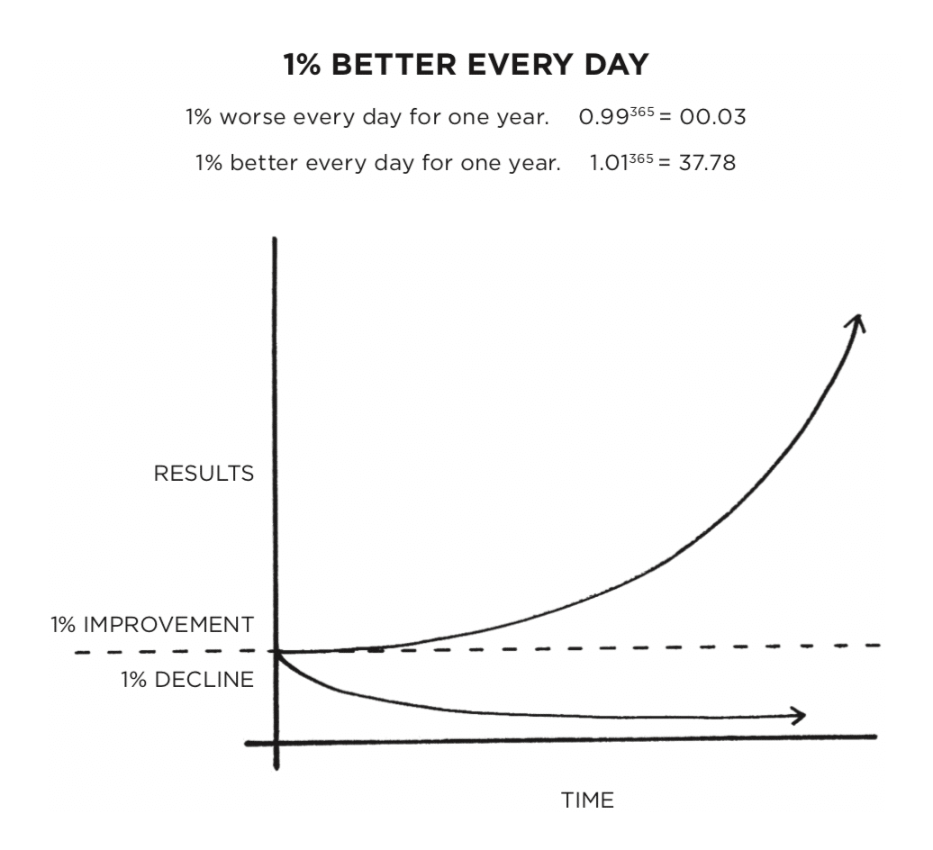
Mastering the chaos – lessons learned
Little improvements are ok
Document everything
Protocols
Goals
Papers
Network
Meetings
Have a system, any system
Today’s goal: suggestions for systems
1st half - Personal (Mehdia)
2nd half - Research (Anthony)
Notes:
Over time, I learned some lessons that really helped me:
Document

Slide 7
Personal Organization
Mehdia N. Rajab Ali

Slide 8
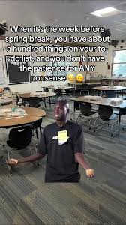
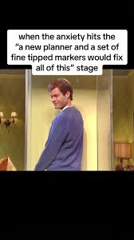
Personal Organization

Slide 9
How to organize your grad school experience?
Grad school experience Organization
Documenting your PhD
Career advancement
Extra-curriculars
Coursework
Research Projects
Undergrad projects
Collaborations
Mentorship
Conferences
Student Clubs
Courses
Project 1
Fellowships
Competitions
Qualifying exams
References & Readings
Internships
Consulting club
Meetings & Discussions
Proposal
Networking events & Seminars
Experiments
Defense
Project 2

Slide 10
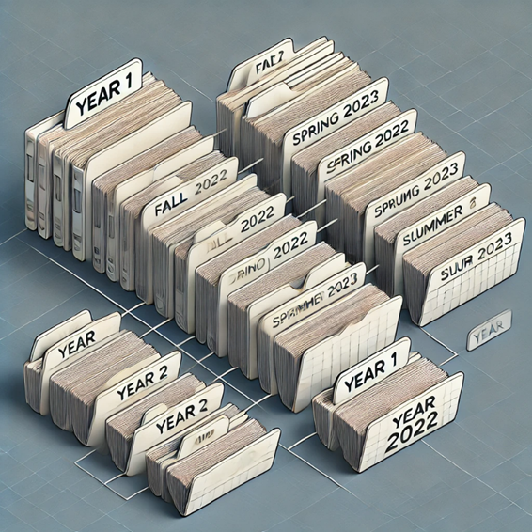
Documenting your PhD – keeping track of milestones, meetings, experiments, decisions
There is no best way to document, the how is less important
You can structure 5-6 years of your PhD by either:
Academic years
Specific years
Notes:
you can divide your PhD journey into stages like "Year 1," "Year 2," and so forth, with each year representing the progression of coursework, research milestones, and dissertation work. Alternatively, you can organize it by semester or term—for example, "Fall 2022 to Summer 2023" for each academic cycle. This semester-based structure can offer a more granular view of goals and timelines, helping to outline specific objectives and tasks for each term. Either approach allows you to track your progress systematically, adapt to any shifts in your research trajectory, and clearly mark the completion of various phases within your PhD journey.

Slide 11
Categories within a year/semester
Coursework
Dedicated folders for each course
Program of study form
RCR
Student Advisor Matching form
Qualifying exams
Proposal
Defense
Notes:
Coursework can be organized into subfolders to keep track of specific academic requirements and milestones. Key subfolders might include Core Coursework (for essential classes and materials related to the field), Qualifying Exam Prep (study materials and notes for comprehensive exams), Proposal (documents and drafts for research proposals), and Defense (resources for preparing the final dissertation defense). This structure helps streamline access to critical documents and keeps the academic journey well-organized. The Core Coursework subfolder includes all essential curricular requirements mandated by the program. This folder houses key documents such as the Program of Study Form, RCR (Responsible Conduct of Research) Certificates, and the student-Advisor Matching Form. It also contains individual folders for each course taken during the semester, allowing for easy organization and access to course-specific materials. This setup ensures that all mandatory academic documents are systematically managed and readily available.

Slide 12
Categories within a year/semester cont.
2. Research Projects
Project 1: 2020-2025_Grant #_Chemotherapy based cell Sorting
References & Readings
Meetings & Decisions
Experiments (organize by theme or instrument used)
09.23-03.24_Drug induced biomechanics
02-34-ongoing_microfluidic sorting
Project 2: 2024-2025 Grant # Natural Killer cell grant
Proposal draft
Illustrations
Notes:
The second major heading under your yearly or semesterly organization should be dedicated to Research Projects. While best practices for organizing research tasks and projects are covered in detail in another section, we’ll briefly introduce a simple method for structuring your research files. For the main Research Project heading, it’s helpful to include the project duration, grant number, and project title in the header to easily identify the work. This main project folder can then be divided into various subheadings for specific aspects of the project. There’s flexibility in how you structure these subfolders, but some useful categories might include Literature Review, Data Collection, Analysis, Results, Manuscripts, and Presentations. This approach helps keep all components of a project organized, making it easy to locate information and track progress.

Slide 13
Categories within a year/semester cont.
3. Undergraduate projects
Create dedicated folders for each undergrad
Learning goals
Research timelines
Weekly updates
Resources
4. Collaborations
Create dedicated folders for each intra-lab or inter-lab collaboration
Parent objectives
Timelines
Task assignments
Communication records
Notes:
Using collaborative tools like Google Drive, Dropbox, or shared institutional folders allows everyone to access important documents such as meeting notes, datasets, protocols, and code in real-time. These platforms enable updates and changes to be instantly visible to everyone involved, promoting transparency and accountability. A structured, shared folder system helps undergraduates stay organized, encourages them to keep their work documented, and makes mentoring and feedback more efficient.
Additional subfolders for meeting notes, raw and processed data, protocols, analysis scripts, and manuscript drafts help to keep the workflow organized and transparent. Real-time collaboration tools allow team members to make updates, comment, and provide feedback seamlessly, enhancing coordination across all stages of the project. Such a structured folder system not only fosters accountability but also simplifies the process of tracking contributions, setting milestones, and managing the project’s progress efficiently.

Slide 14
Categories within a year/semester cont.
5. Mentorships
Learning Goals
Initial assessments
Skill-building
Target competencies
Development Plans
Milestones & timelines
Meeting Notes
Progress Updates
Feedback & Reflections
Notes:
Organizing mentorship materials into subfolders can greatly streamline the mentorship process, making it easy to track progress, share resources, and provide feedback. Within a primary mentorship folder, you can create subfolders dedicated to specific areas, such as Learning Goals, Development Plans, Meeting Notes, Progress Updates, and Feedback & Reflections. A Learning Goals folder can house initial assessments, skill-building objectives, and target competencies, while a Development Plans folder can outline key milestones and timelines. Meeting Notes and Progress Updates folders help both mentor and mentee stay aligned on goals and achievements, with regular updates providing a documented record of the mentee’s journey. The Feedback & Reflections folder is valuable for storing constructive feedback and self-reflections from the mentee, fostering a growth-oriented approach. Using shared platforms like Google Drive or Dropbox allows both parties to access and update these folders in real time, facilitating a collaborative and structured mentorship experience.

Slide 15
Categories unspecific to semesters
Career Advancement
CVs
Conferences
Abstracts
Agendas
Presentations/Posters
Fellowships
Application
Recommendation letters
Project proposals
Important deadlines
Internships
Interview notes
Offer letters
Networking events & Seminars
Event schedules, speaker information, resources, follow-up emails etc.
Notes:
All materials and activities related to building your professional profile can be organized under a Career Advancement folder. This includes essential documents like CVs and resumes, as well as applications for conferences and fellowships. You can also keep track of opportunities such as internships, networking events, and seminars that contribute to skill development and professional growth. Having a centralized folder for career-related advancements ensures that your achievements and ongoing efforts are organized, making it easier to access and update as you progress.

Slide 16
Categories unspecific to semesters
2. Extra-curriculars
Student Clubs
RIC
Academic resource committee
Finance
Marketing
Mentorship Programs
Competitions
3. Health & Wellness
Meal prep/recipes
Work out plan
Health Insurance
4. Finances
Budgeting
Bills & Payments
Savings & Investments
Taxes

Slide 17
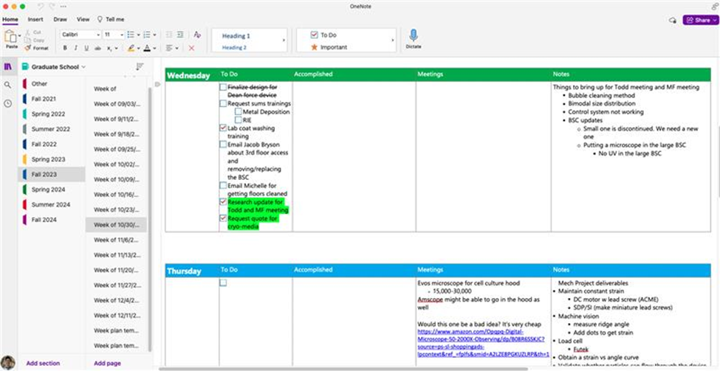
Software/Tools to organize
OneNote: use the notebook and section layouts to categorize projects, notes, and data.

Slide 18
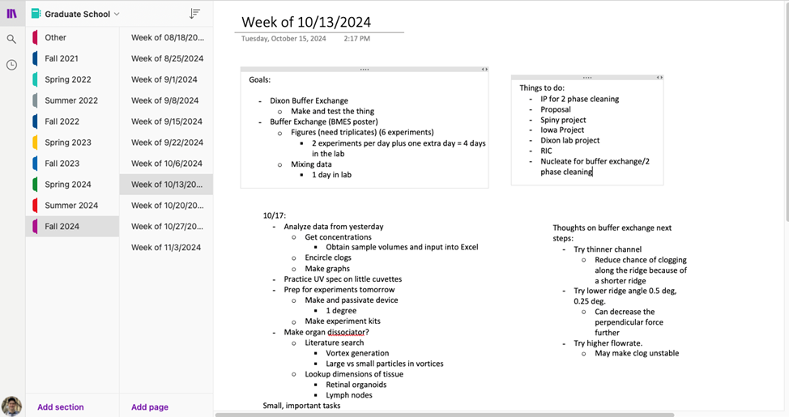
Software/Tools to organize
OneNote: can create pages within sections of a notebook

Slide 19
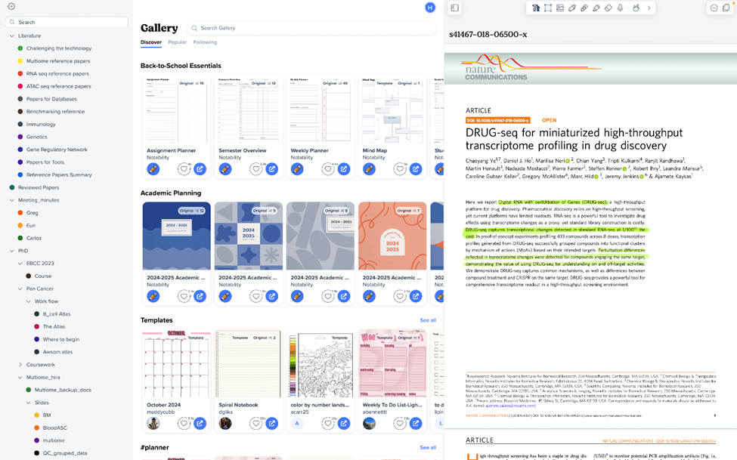
Software/Tools to organize
2. Notability: can create folders, annotate PDFs, audio recording, calendar and in-built templates

Slide 20
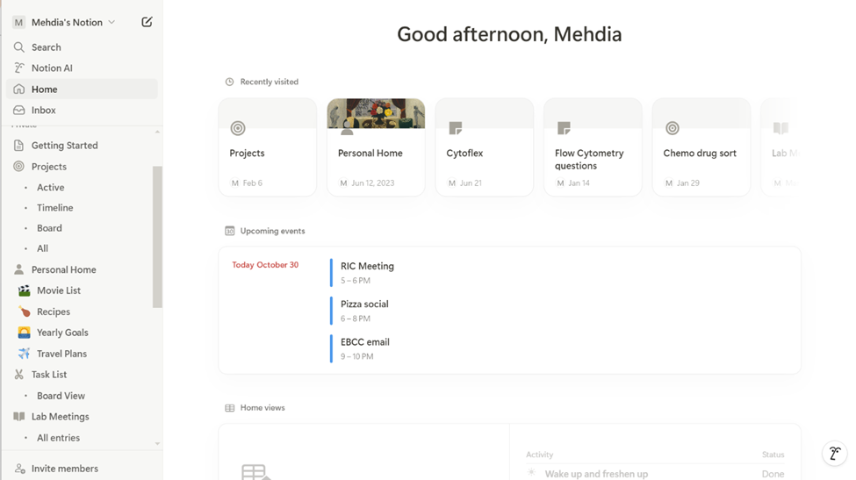
Software/Tools to organize
3. Notion: flexible database structure, manage notes, tasks, and project timelines

Slide 21
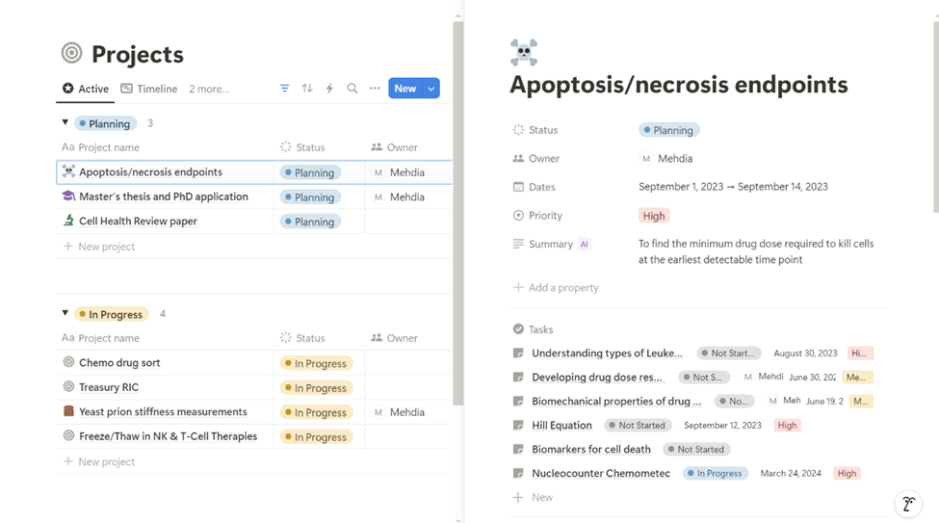
Software/Tools to organize

Slide 22
Research Organization
Anthony Compton

Slide 23
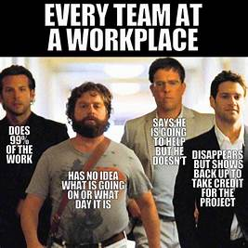
Research Organization

Slide 24
Core Tenets of Research Organization
Recording as much as you can
Information storage and upkeep
Working with others on the project
Coordination/Communication
Conveying information

Slide 25
First Rule of Research Organization...
Project Folders are..
Online and backed up
Dropbox, OneDrive, Benchling
Shared with anyone working on the project
Contains related information
Organized into subfolders with specified information

Slide 26
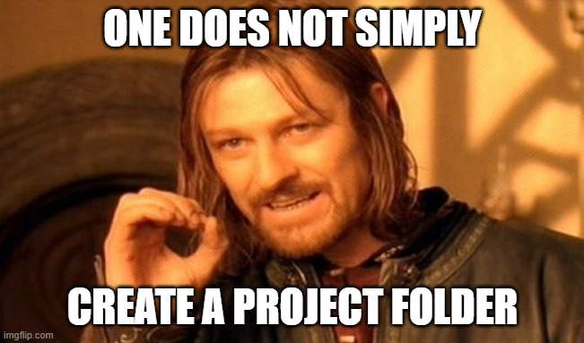
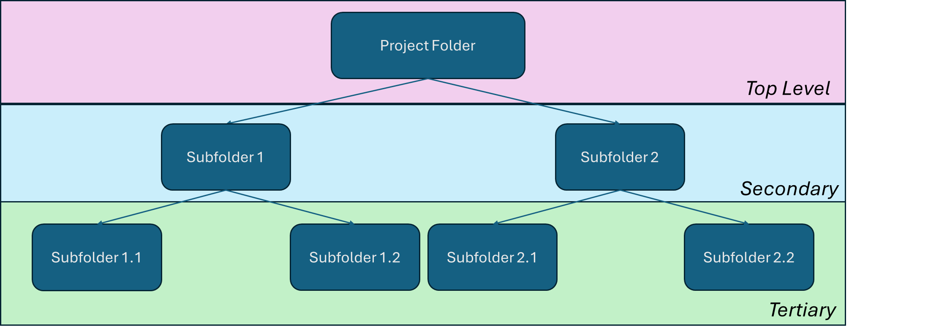
How does one set up a project folder??
File Hierarchy
Order of subfolders within the primary folder
Any file/folder within a folder should be related to the bigger folder

Slide 27
Different Types of Levels
Categorical
Folders are named using words
Qualitatively describes the information stored within
Chronological
Folders are named using dates
All of the information stored within are related to that date

Slide 28
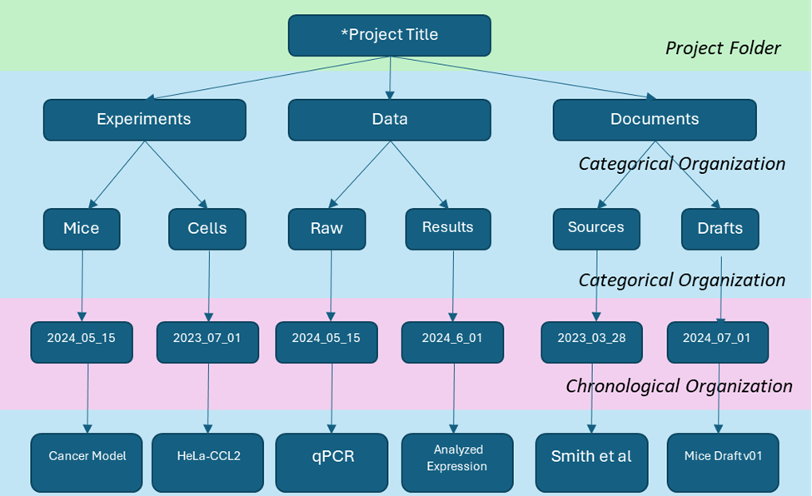
Putting it all together...

Slide 29
Organize to your taste!
Many different projects will consist of different levels of organization
Not all subfolders have the same number of hierarchal levels
Files tend to be at the bottom of the hierarchy
Do what works for you
Be consistent
Be descriptive
Easy to follow

Slide 30
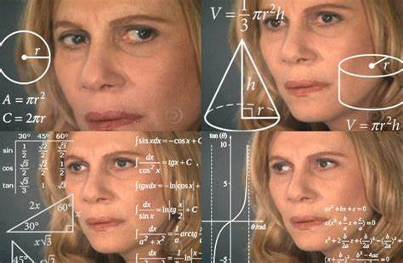
File Comprehension
Tells everyone going through the project folder what in the world is going on
Includes yourself! You can’t remember everything!
Improve comprehension?
Descriptive Filenames
"ReadME" Files
Me looking at my old files

Slide 31
File Comprehension: Filenaming
Start with the date of the file's creation
Convention: yyyy_mm__dd or yyyymmdd
Any specific descriptors
Information type, conditions, equipment used, etc.
End with numbers when applicable:
Replicate numbers
Version numbers: v01
Use 0s to fill in the higher place numbers to maintain numerical order
"V02" would be ordered before "V10" unlike "V2"

Slide 32
File Comprehension: Filenaming
Personal Example

Slide 33
File Comprehension: "ReadMe" Files
What are ReadMe files?
Text files that describe the files/folders that are organized at the same level of hierarchy
Observations, Comments, Procedures, Notes, Mishaps, etc
Filename acronyms
Facilitate you, your project team, and your readers’ understanding of what went right and/or wrong
Info dump

Slide 34
File Comprehension: "ReadMe" Files
Personal Example

Slide 35
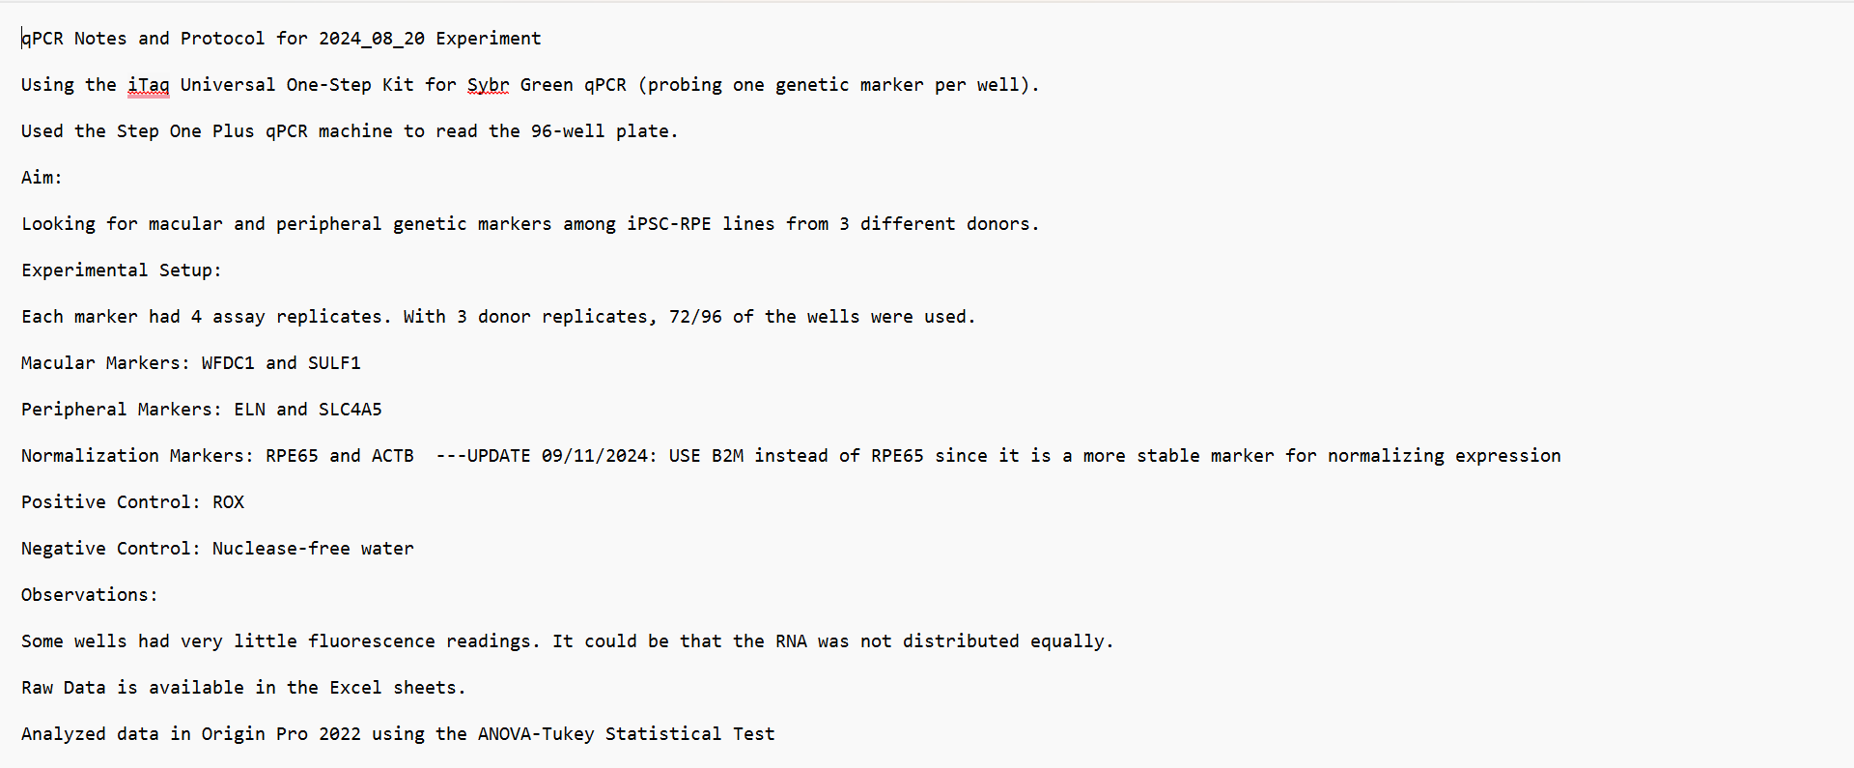
File Comprehension: "ReadMe" Files

Slide 36
Questions?
Scan to log attendance
If interested, reach out to Steven Swingle → steven.swingle@gatech.edu​
Find us on Engage https://gatech.campuslabs.com/engage/
Follow us on instagram
@gatech.ric
Research Insights Club

