Slide 1
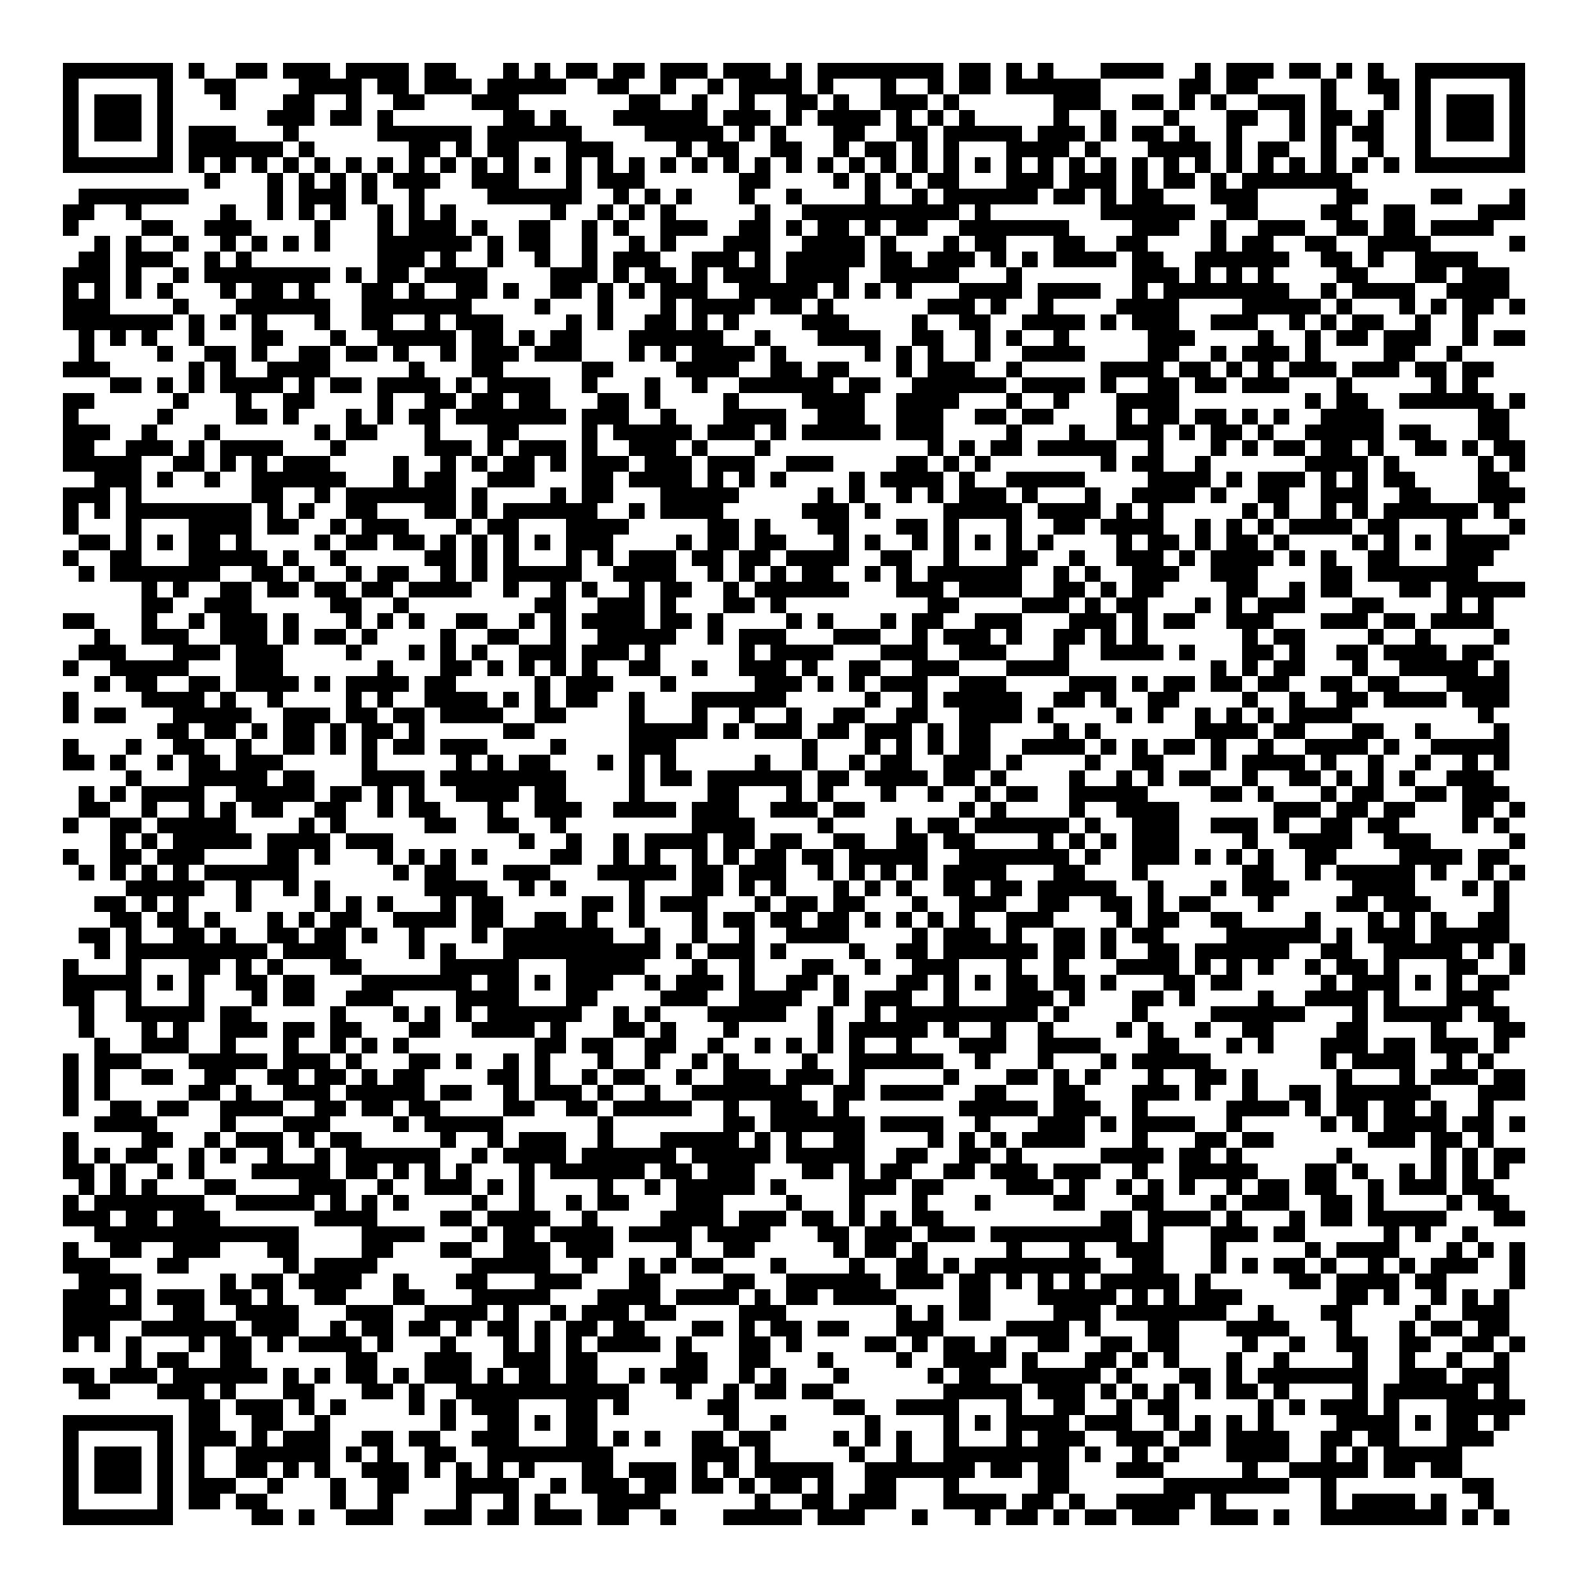
Research 101
Mark your attendance!
Information for the Research Curious
Research Insights Club

Slide 2
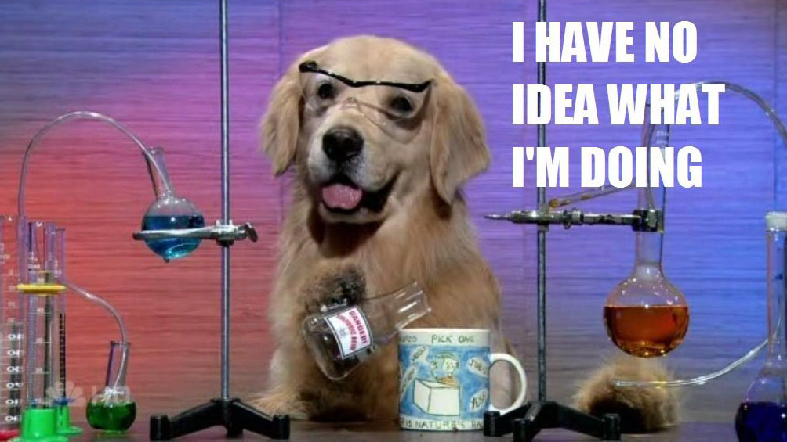
Our Purpose
(1) To disseminate detailed and hard-to-obtain knowledge to Georgia Tech students to help them navigate and thrive in the complex field of academic research.
(2) To facilitate knowledge transfer and networking between student researchers outside their usual fields.
Insights
Implementation Strategy
Research Insights Club
Faculty seminars
How to read papers efficiently
Useful research tools
Student panels
Presentation skills
Networking
Applying for fellowships
Teams channel
Project organization
File management
Outreach events
Tips for mentoring undergrads
Blog

Slide 3
Today’s goal: demystify research

Slide 4
What brings you here?

Slide 5
The benefits of research
Work on interesting projects
Explore your interests
Mentorship from professors
Companionship from lab
Build up resume for future research roles (Ph.D., industry)
Writing & presentation skills will get a huge upgrade

Slide 6
Topics
What is research
Who does research
Academic labs
What do researchers do
How is research funded
Where do researchers communicate their research?
Journals
Author order meaning
How is the research impact of a person measured?
Next steps: how to get involved in research

Slide 7
What is Research?

Slide 8
Research is...
n. "the systematic investigation into and study of materials and sources in order to establish facts and reach new conclusions"
v. "to investigate systematically"
The scientific method
Using evidence to test hypotheses and come to new conclusions

Slide 9
Who does research?
Industry
R&D
Government
CDC
DoD
NASA
Academics
Research Faculty
Graduate students
Masters, Ph.D.
Postdocs, research scientists
Undergraduates

Slide 10
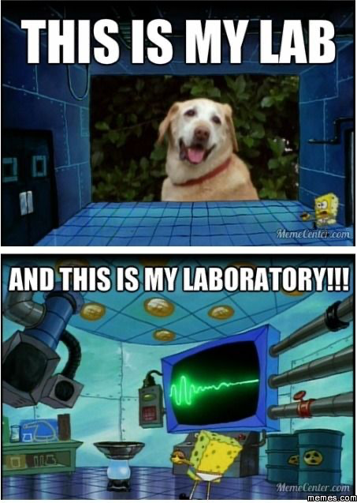
Research Groups

Slide 11
The academic lab
Principal Investigator (PI)
Graduate Students
Postdocs
Research Scientists
Undergraduates

Slide 12
The PI
Professor/Research Faculty
“Manager” of the lab
Apply for grants, publish papers, go to conferences
“Faculty” are the academics including professors, teaching faculty & research faculty
“Staff” have admin or other support roles

Slide 13
Professors have many duties

Slide 14
The PI leads the lab
Hire students & postdocs
Mentor students & postdocs
Decide what projects to pursue
Make sure papers get written
Apply for funding
Write grant proposals
PIs rarely (if ever) work in the lab!

Slide 15
The road to tenure is long
Assistant Professor
Associate Professor
Professor
PostDoc
5-7 years
Tenure
7 years
2-4 years
Goal: publish as much as possible before tenure evaluations!

Slide 16
What do Researchers Do?

Slide 17
Academic Researchers
Undergraduates
Graduate Students
Postdocs
Research Scientists
Typically volunteers
Employees

Slide 18
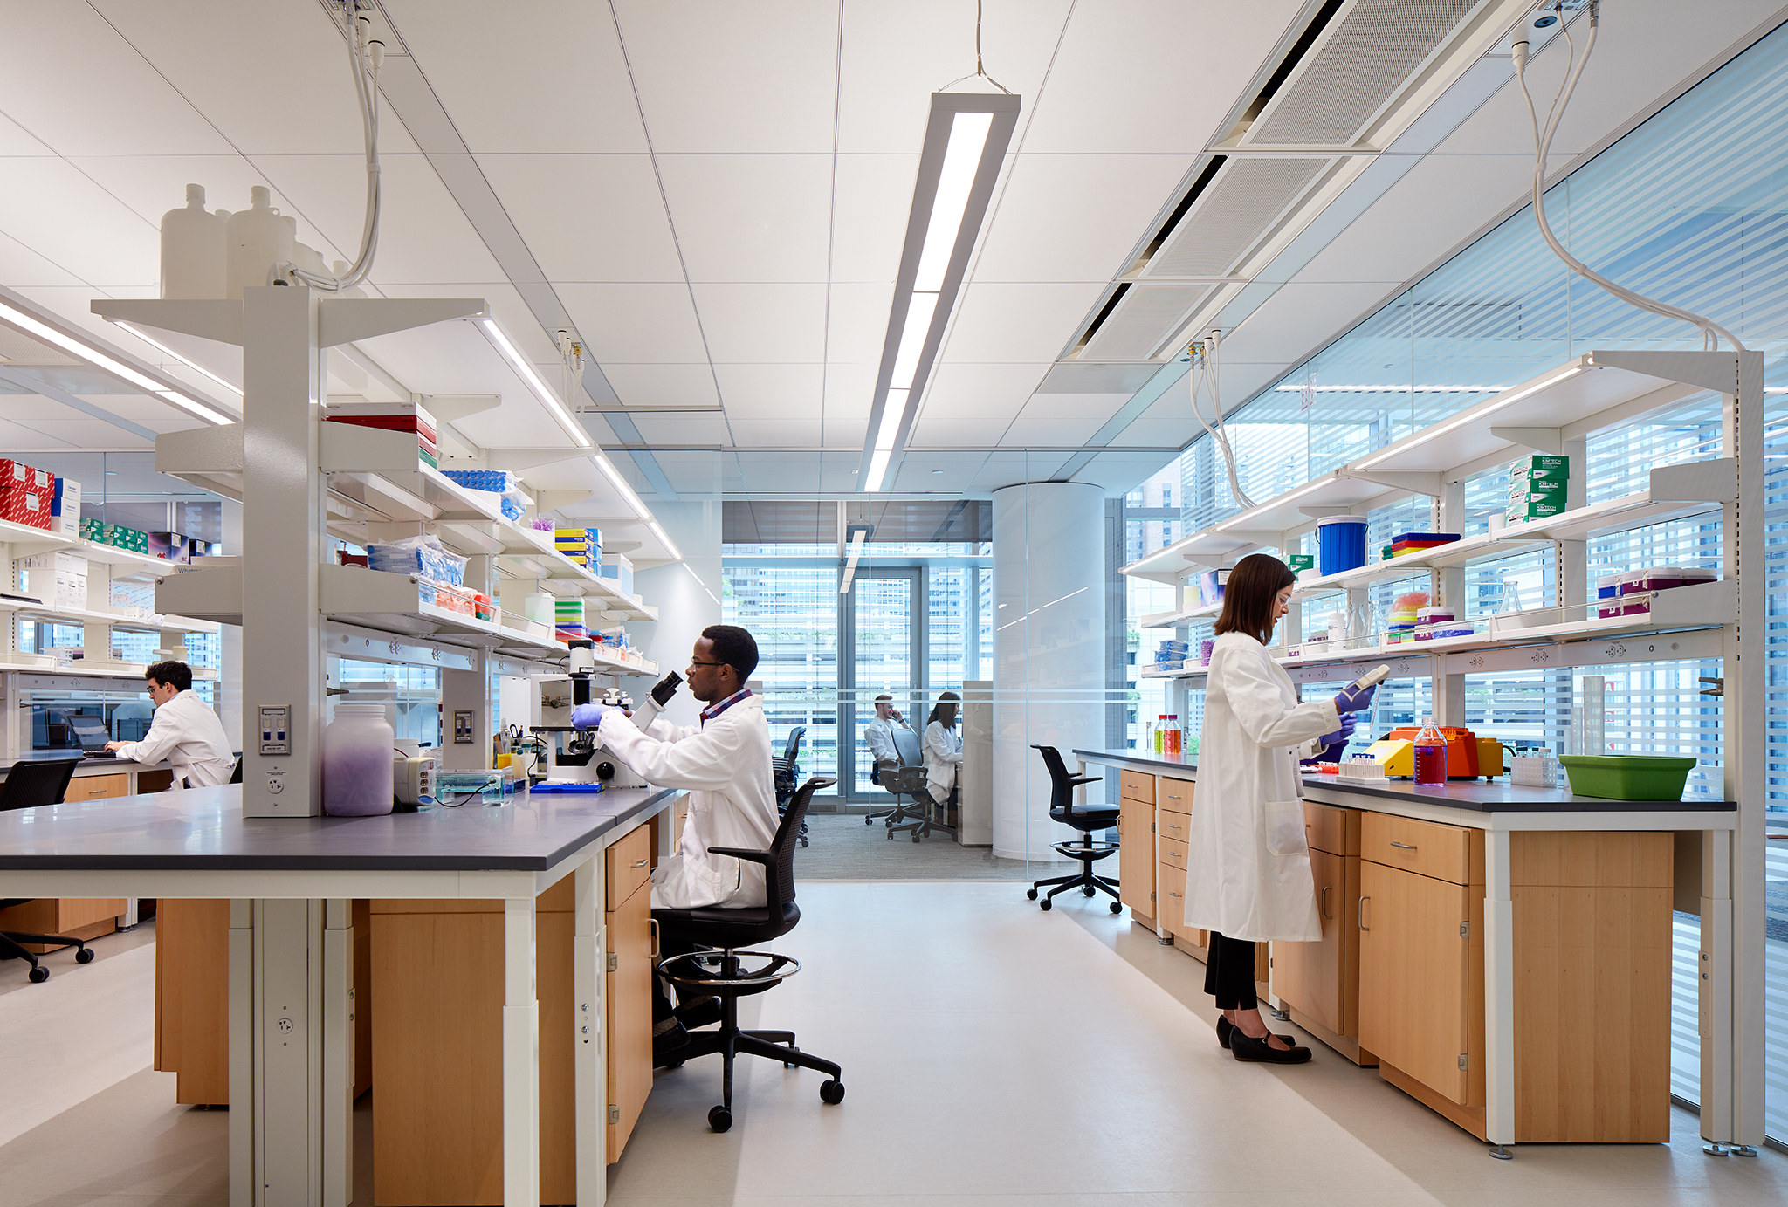
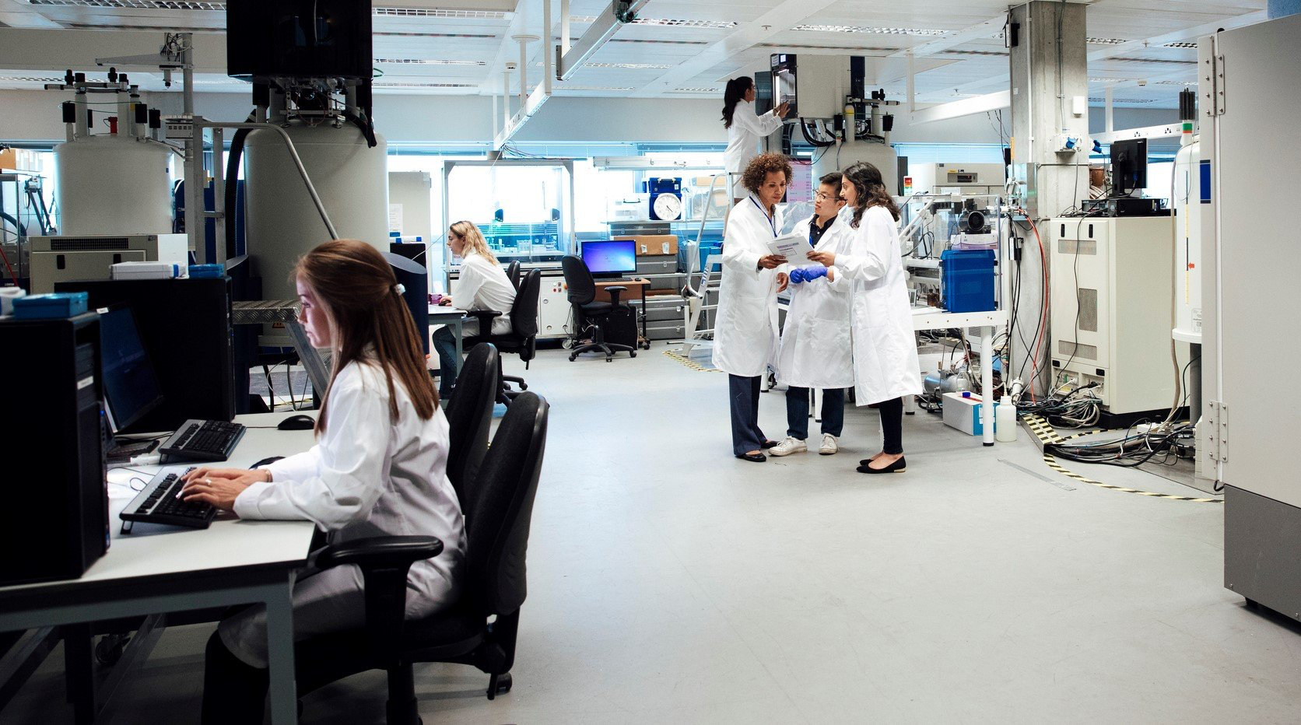
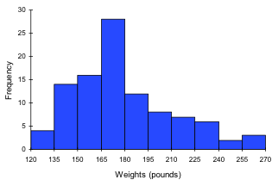
What do researchers do
They do the research
Collecting Data
Analyzing Data
Not a professor in sight
Research can be experimental or computational/theoretical
Notes:
Call out Mehdia or Hoseyn

Slide 19
What to expect from research as an undergraduate
Assist a graduate student or postdoc
Training, shadowing
Reading papers, learning about the field
Perform your own task
Experiment
Create a tool
Gain independence over time
If you do enough, you can become a co-author or present at a conference
you

Slide 20
Publishing & Conferences

Slide 21
Journal articles: the currency of research
aka “research paper”
Article in a scientific journal
Two types
Primary research
Reviews
Found on research databases
Google Scholar
PubMed
Elsevier
Peer-reviewed
2+ experts thoroughly read and “signed-off” on your paper
Examples of Journals

Slide 22
The structure of a research paper
Abstract
Introduction
Methods
Results
Discussion
Conclusion
References
Supplemental Information

Slide 23
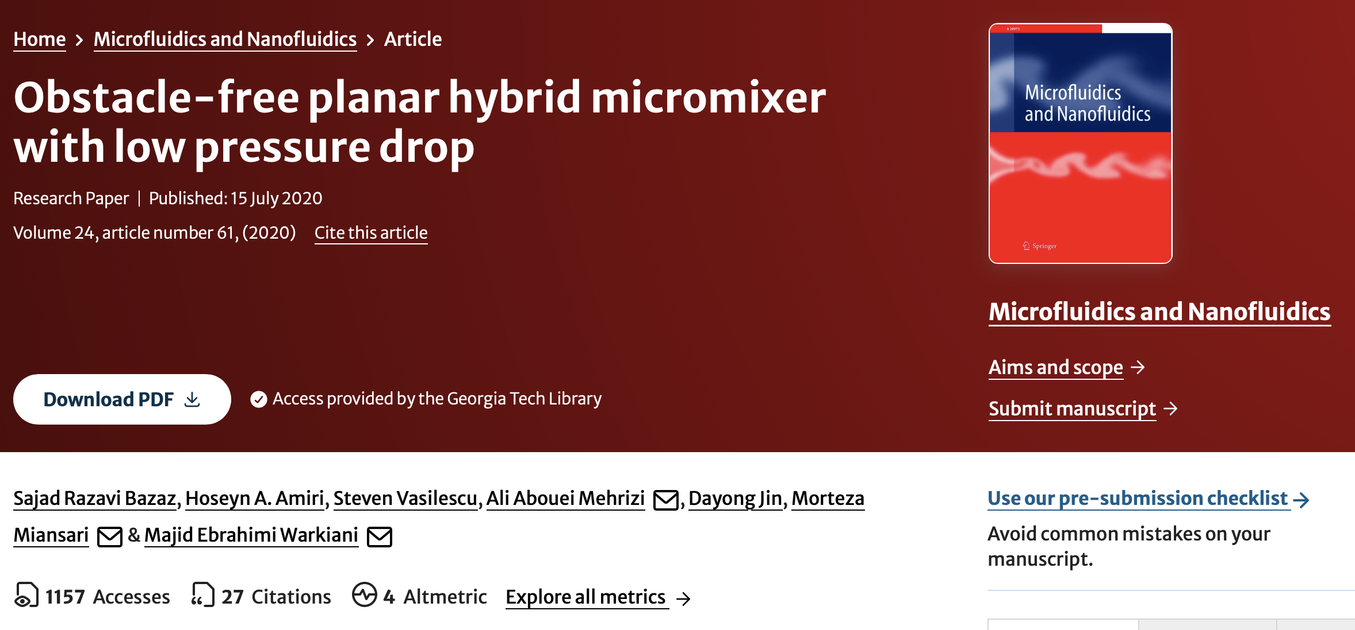
Paper example
1st author – did the most work*
Last author – the PI*
*This can vary depending on the field
Question: what is the name of the journal?

Slide 24
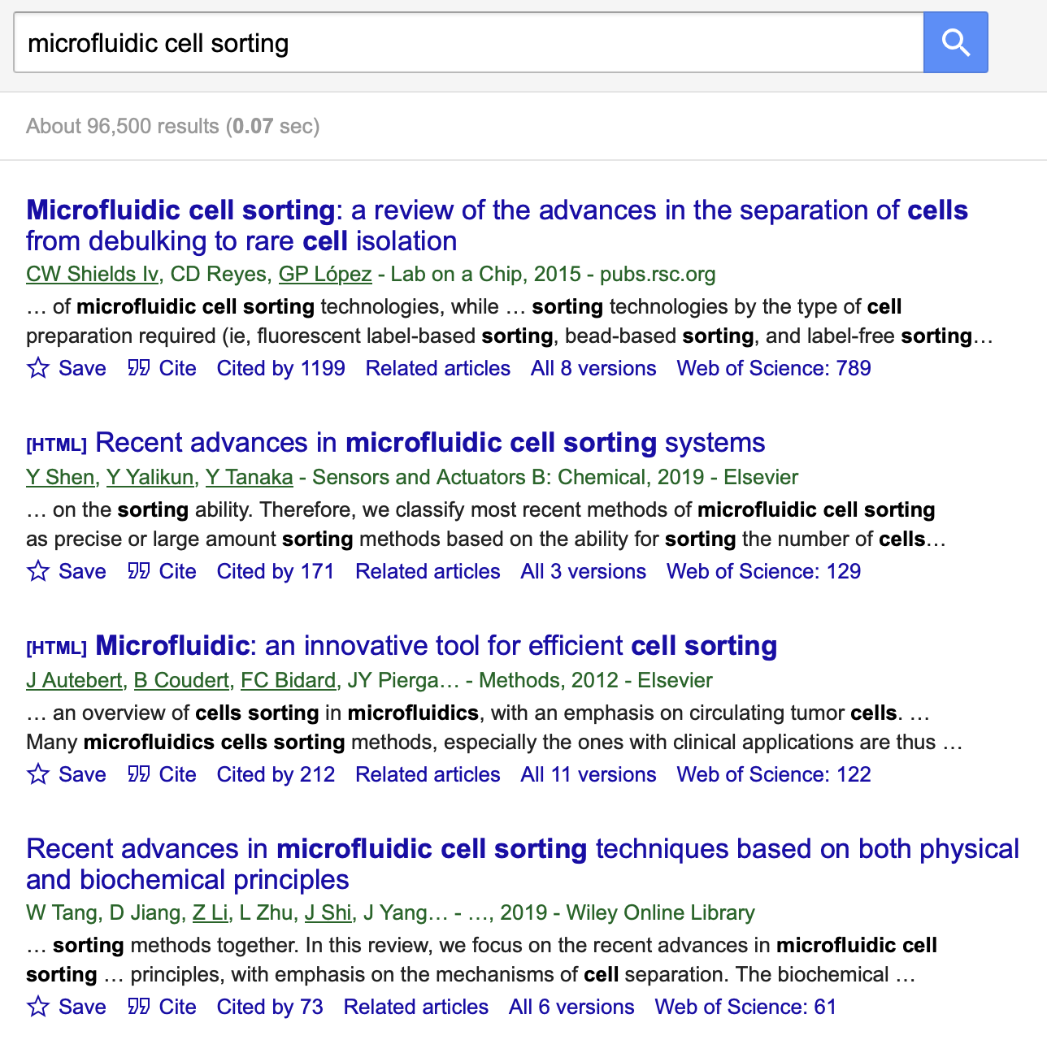
Research impact: citations (for better or worse)
Citations are references to your work
Impact metrics:
Individuals – h-index
The highest number of a person’s papers with at least that number of citations
Journals – Impact Factor
Example: Nature
Note the citation counts

Slide 25
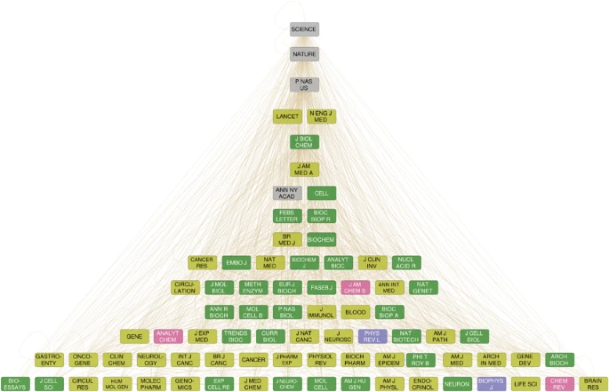
Journal “hierarchy”
Note: higher journal doesn’t mean better research. Sometimes impactful projects are split up into multiple publication in smaller journals
PUBLISH

Slide 26
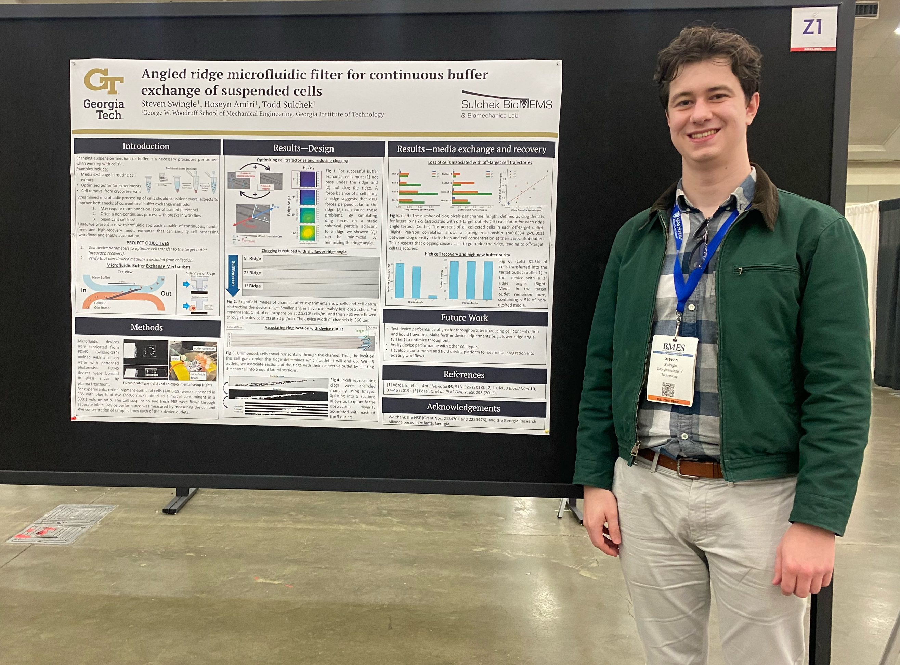
Conferences
Field specific
Students (sometimes profs.) submit abstracts & present their research
Oral presentation
Poster
Networking

Slide 27
Starting Your Research Journey

Slide 28
I’m interested! Now what…?
Learn about labs and their projects
Department website
Research
Research area
Faculty
Lab websites
Reach out & apply
Email professors
Make sure you follow instructions on their website!
PairMe
Search “pairme gatech”

Slide 29
Advice
Have an idea of what you’re interested in
More specific than “wet lab”
When emailing professors:
State what interested you and made you want to reach out
Don’t feel impostor syndrome. Say “I found ______ interesting and am looking to learn more in your lab.”
Be curious! Learn. Then steer your ship.

Slide 30
Questions?

Slide 31
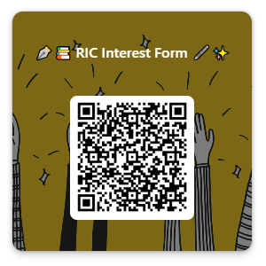
If interested in RIC
Fill out interest form!
We’ll reach out depending on what you select

