Slide 1
Mastering the Chaos: Organize your Research like a Pro
Scan to log attendance
Featuring:
Mehdia N. Rajab Ali
Anthony Compton
Research Insights Club

Slide 2
Our Purpose
(1) To disseminate detailed and hard-to-obtain knowledge to Georgia Tech students to help them navigate and thrive in the complex field of academic research.
(2) To facilitate knowledge transfer and networking between student researchers outside their usual fields.
Insights
Implementation Strategy
Research Insights Club
Faculty seminars
How to read papers efficiently
Useful research tools
Student panels
Presentation skills
Networking
Applying for fellowships
Teams channel
Project organization
File management
Outreach events
Tips for mentoring undergrads
Blog

Slide 3
Join us!
Students & researchers at all levels welcome
If interested, reach out to Steven Swingle → steven.swingle@gatech.edu
Find us on Engage https://gatech.campuslabs.com/engage/
Follow us on Instagram @gatech.ric

Slide 4
Making scientific Figures
Mehdia N. Rajab Ali

Slide 5
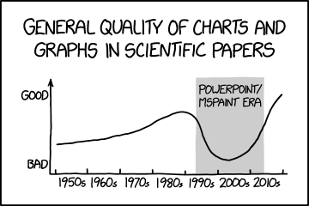
“People make snap judgements based on visuals, and if they don’t look good, they can steer someone away from a paper that otherwise they might like to read.”
- Kelly Krause, creative director for the Nature family of journals

Slide 6
Types of Scientific Figures
Scientific Figures
Drawings & Diagrams
Primary Evidence
Graphs
Micrographs
Line graphs
Drawings
Diagrams
Gel Electrophoretograms
Scattergrams
Anatomy
concepts
Concrete things
Processes
Polygraph Recordings
Bar graphs
Apparatus
Flow systems
Frequency polygons
Patient photographs

Slide 7
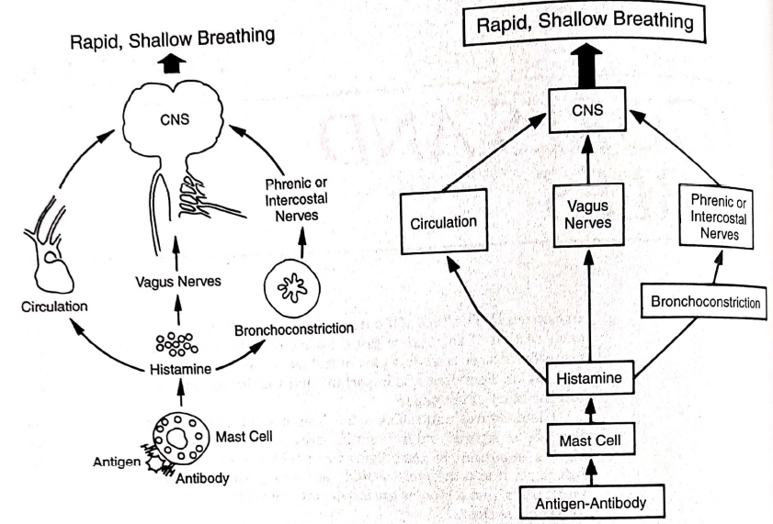
Drawings and Diagrams
Drawings:
Illustrate anatomy, apparatus and other concrete things
preferred for animals and apparatus
Diagrams:
Illustrate concepts
Realistic vs Schematic Diagram
Notes:
What general guidelines can u identify from this diagram? Black and white, labels are large enough, Letters can be uppercase or lowercase, sans serif type font is preferred

Slide 8
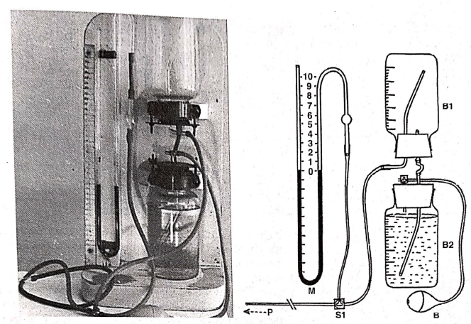
Drawings and Diagrams
Drawings:
Illustrate anatomy, apparatus and other concrete things
preferred for animals and apparatus
Diagrams:
Illustrate concepts
Photograph vs drawing of an apparatus
Notes:
When would u choose a photograph vs a drawing?

Slide 9
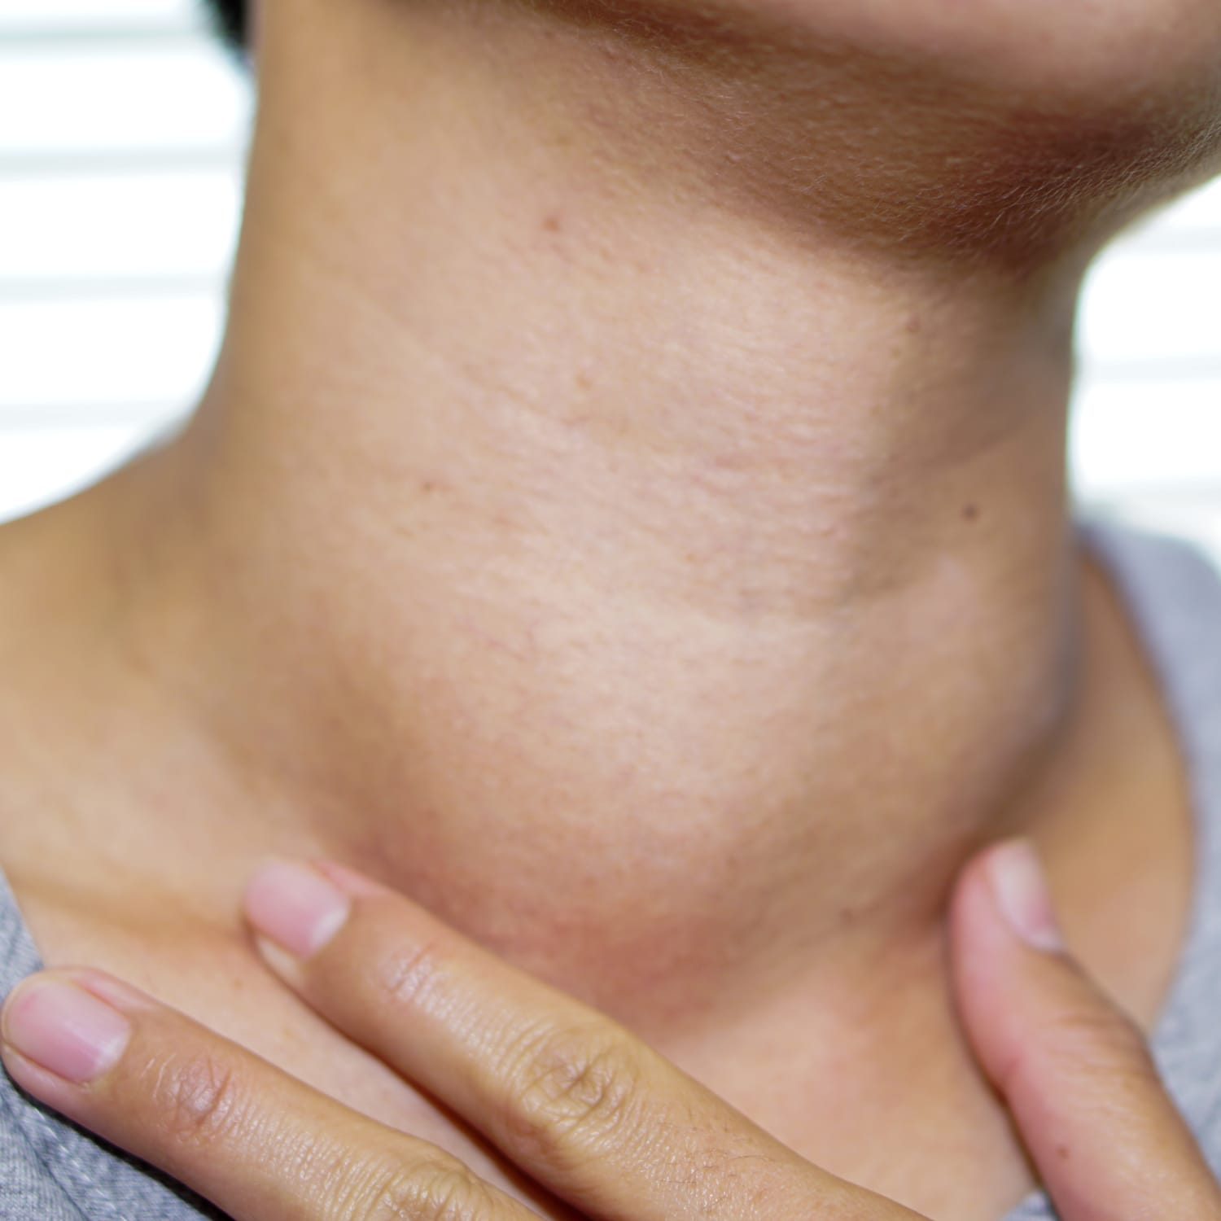
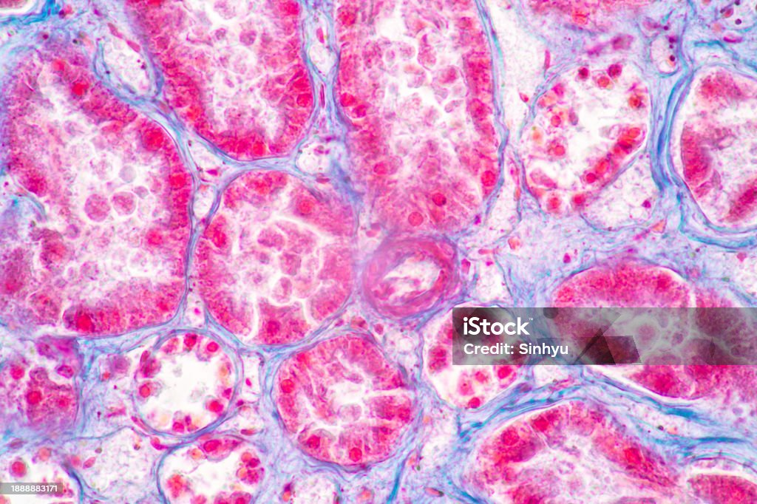
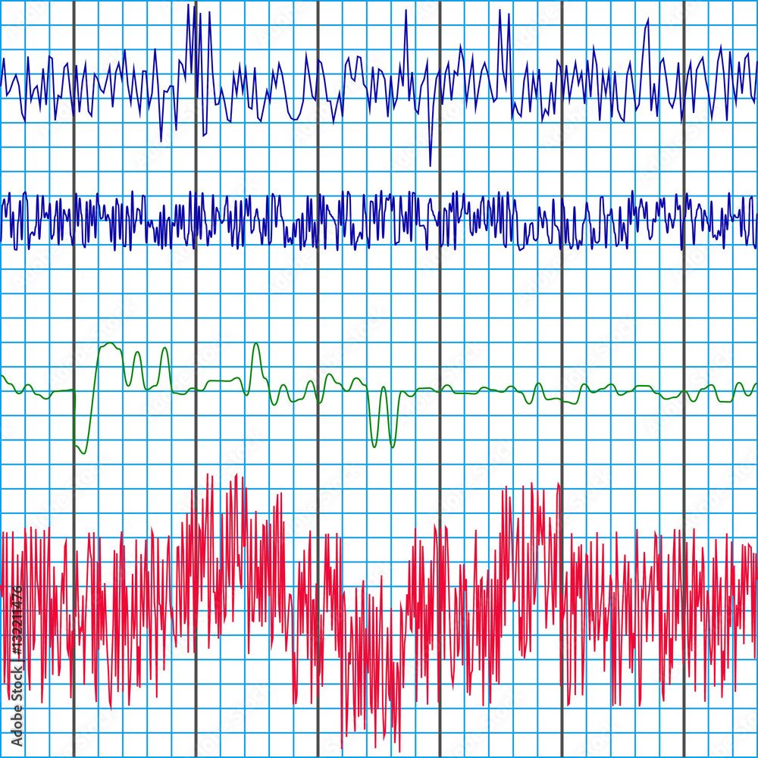
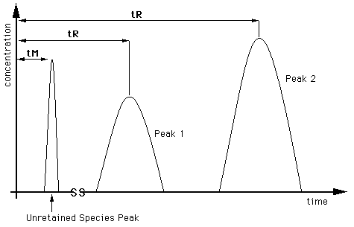
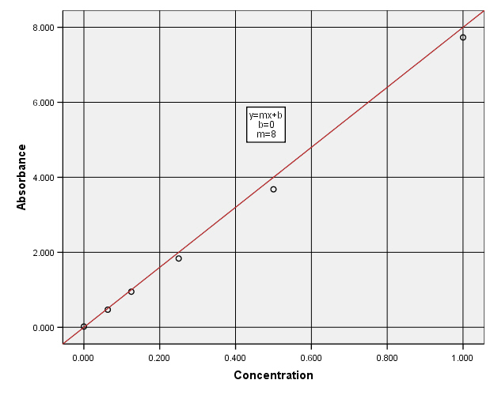
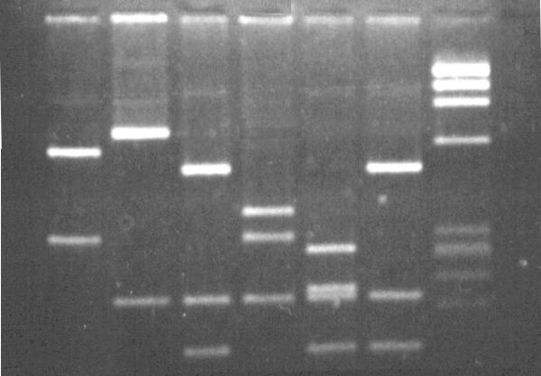
Primary Evidence
Patient pictures
Histology Images
Micrographs
Polygraph recordings
Chromatograms
Spectrophotometer curves
Gel electrophoretograms

Slide 10
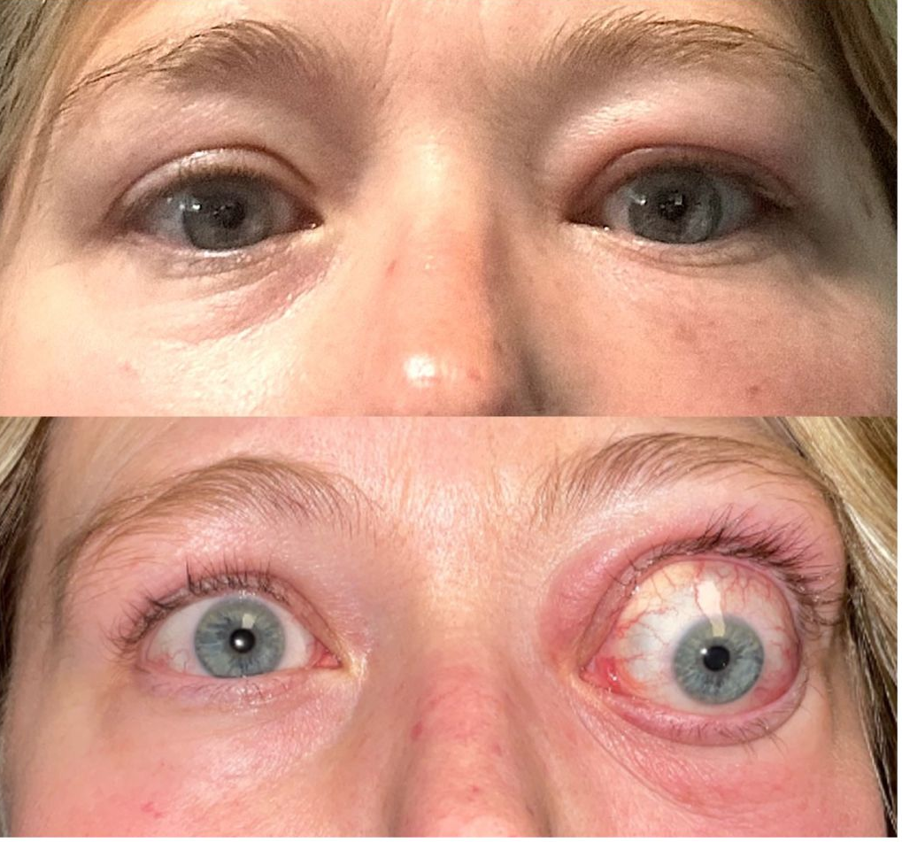
Primary Evidence contd.
Indicate Quality of data
Select your best quality recording for publication
Photographs of Patients
Make sure you have informed consent
Cover facial features to deidentify patient
Use letters such as A,B,C to refer to patients, not their initials
Thyroid eye disease
Notes:
Make glossy prints of micrographs and ensure that the print
have sufficient contrast to make the features of interest clear. s

Slide 11
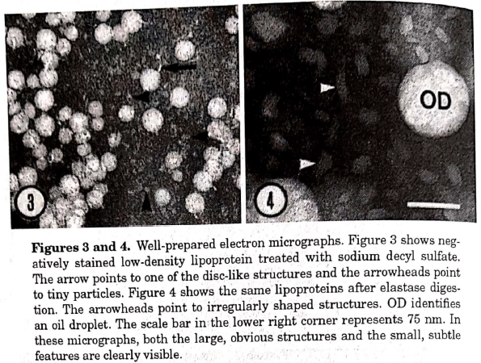
Primary Evidence contd.
Micrographs
Clarity
Size
Large enough to show important features
Labelling
Include arrowheads, letters, numbers and symbols
Scale bar
Plates
Numbering

Slide 12
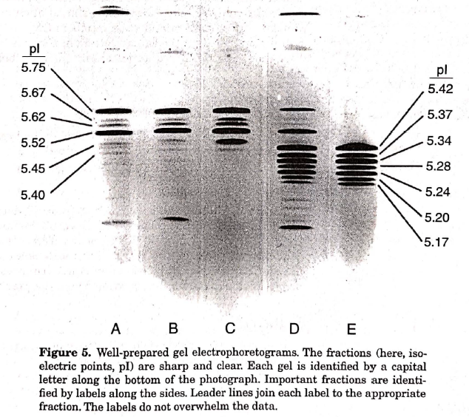
Primary Evidence contd.
Gel Electrophoretograms
These are halftone figures
Identify material in each gel by adding capital letters or labels along the top or bottom of the photograph.
Identify important fractions by adding labels along the side
Use leader lines to join labels to their fractions
Labels & letters should not overwhelm the data

Slide 13
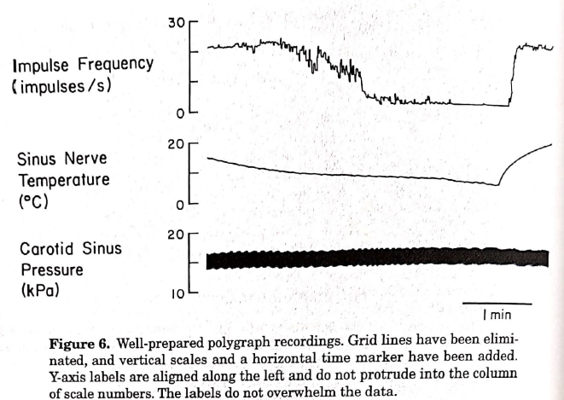
Primary Evidence contd.
Polygraph Recordings
Label axes
Use IS abbreviations for units of measurement
Horizontal oriented axis labels should align on the left
Labels should not overwhelm data

Slide 14
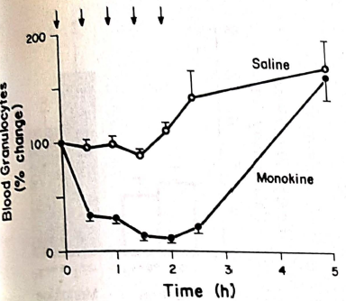
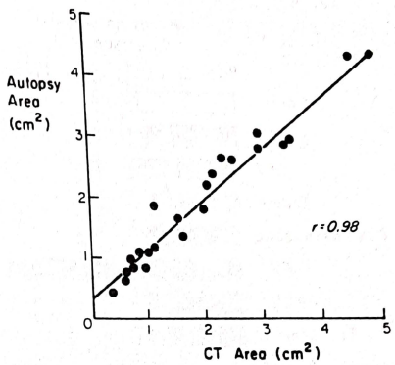
Graphs
Selecting the appropriate type of graph to display the type of data you have in important
Line Graphs
A two-axis graph on which curves, data points or both show the relation between two variables.
Scattergrams
A scattergram is a two-axis graph that plots individual data points and fits a mathematical function to the points to show how strongly two variables are correlated.
Line Graph
Scattergram

Slide 15
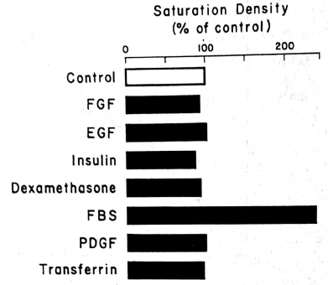
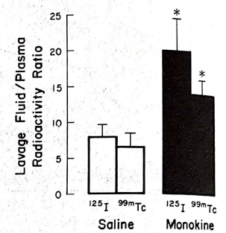
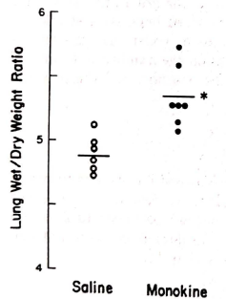
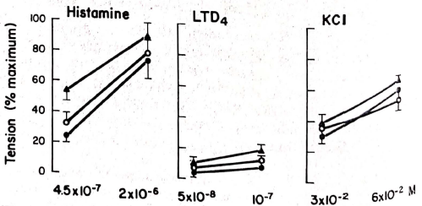
Graphs
Bar Graphs
A bar graph is a one-axis graph that compares amounts or frequencies for classes of a discontinuous variable
Maybe horizontal or vertical
Individual-Value Bar Graph
It is a variation on vertical bar graphs in which individual data points are shown either in addition to the mean or instead of the mean.
Paired data lines can be drawn t show the direction of change
Horizontal Bar graphs
Vertical Bar graphs
Individual-value bar graph
Individual-value bar graph

Slide 16
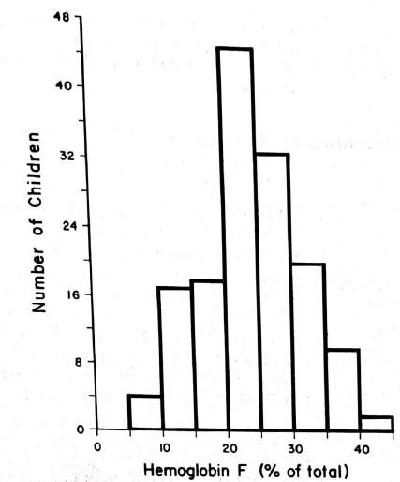
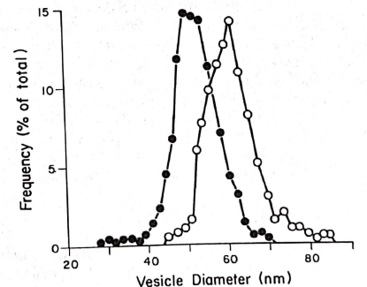
Graphs
Histograms
A two-axis graph that shows a single frequency distribution by means of a series of continuous rectangles, the area of the histrogram represents the distribution.
Frequency Polygons
A two-axis graph that uses data points joined by lines to show two or more overlapping frequency distributions. Data points are plotted at midpoint of each class.

Slide 17
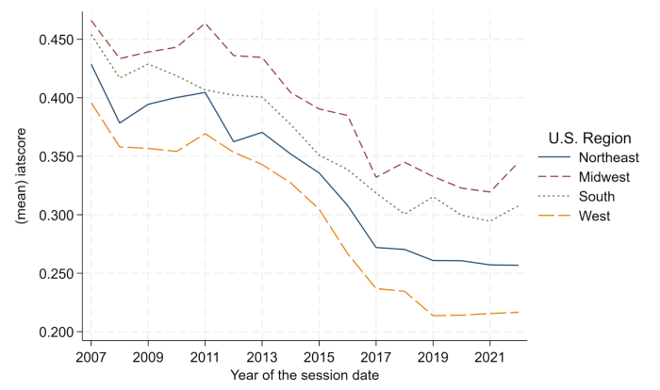
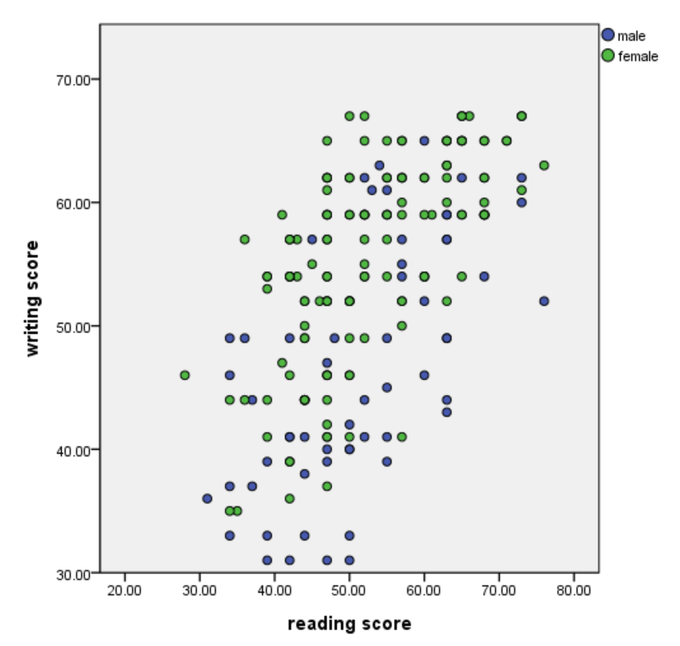
General Guidelines for Figures
Readability
Lettering should be large enough
Symbols and shapes should be easy to differentiate
Emphasis
Use different line weights
Point
Each figure should make a clear point
Pick a palette
Do not use rainbow
Avoid Red
Notes:
For example, in line graphs, curves should be the darkest lines, letters in axis labels .should be less dark and axes tick marks error bars, keys, and curve labels should be least dark

Slide 18
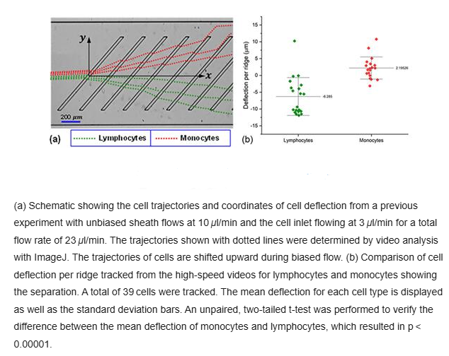
Figure Legends
Typically has 4 parts:
A brief title
Experimental details
Definitions of symbols, line or bar patterns
Statistical information (for graphs)

Slide 19
Figure Legend title
Titles for Drawings, Diagrams, Primary Evidence
The title should identify the type of figure shown, if necessary, and the specific apparatus, concept for specimen

Slide 20
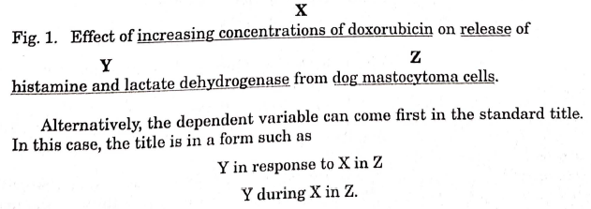
Figure Legend title
Titles for Graphs
For a graph that depicts the results of an experiment in which manipulation was made and a variable measured or observed, the standard title is
Effect of X on Y in Z

Slide 21
Figure Legend title
Titles that state a Point
Other than the topic of the graph, the title can also state the point the graph is making. For example
Inhibition of X on Y in Z
Avoid using overloaded titles and abbreviations in titles

Slide 22
Figure Legend title
Titles for Composites
The title should indicate the common topic illustrated in all the parts of the composite so that reader understands why is it grouped together.

Slide 23
Figure Legend title
Experimental Details
Just enough to permit the reader to understand the figure.
Statements such as “For details, see Methods are unnecessary”

Slide 24
Figure Legend title
Statistical Information
Should include whether the data points or bars represent individual, mean, or median values, whether error bars represent SD or SEM, CI or ranges and the sample size (n).

Slide 25
Tools & Resources
Biorender
library of around 30,000 life-science icons that can be easily turned into scientific illustrations
Free Images
Servier Medical Art
Reactome
BioIcons
Thenounproject

Slide 26
Scientific
Writing
Anthony Compton

Slide 27
Introductory Question
Show of hands...
Do/Would you read the entire scientific article (start to finish w/o skipping lines)??
Why or Why not?

Slide 28
Introductory Question (cont.)
The truth is...
many don't read the full text.
Many people skim through to identify the major arguments/points.
Knowing the reader's behavior is key for scientific writing.

Slide 29
Objectives of Scientific Writing
Communicate the primary points
Scientific Question/Problem
Hypotheses
Evidence
Interpretations
Make the primary points memorable for readers
Making statements accessible across disciplines

Slide 30
The #1 most common rule for writing...
Keep it concise. Short/Simple = quick and easy to read
Use short, simple sentences
Split up compound sentences
Avoid long dependent clauses
Keep terminology as basic as you can
Try to avoid
Drifting to tangential topics
Using excess wording
"very", redundancies, "that..."
Using too many new acronyms
Common acronyms w/in a field are ok

Slide 31
Example/Discussion
Passage 1
This investigation proposes a novel combination of approved therapies to treat B-cell leukemia, which we are the first to compare doxorubicin and inotuzumab ozogamicin individually and in combination with other methods.
Passage 2
This investigation proposes the novel combination treatments with doxorubicin and inotuzumab ozogamicin to treat B-cell leukemia. We are the first to compare both drugs individually and in combination with other methods.

Slide 32
Stress the Main Points!
Make points both clear in understanding and visuals
Understanding: Use signaling language to guide readers
Ex: Key, novel/new, innovative, significant, therefore, in conclusion
Visual: Make key statements visually distinct from your text
Hypothesis, statement of significance/innovation, important conclusion/interpretation
Italicize or underline or bold (never at the same time)
Main points will be memorable to readers no matter their style

Slide 33
See the Difference
Age-related Macular Degeneration (AMD) is responsible for 21.6% of permanent blindness in high-income nations, and its incidence is increasing annually. Three-dimensional retinal engraftments produced from patient-derived induced pluripotent stem cells (iPSCs) have been proposed as a regenerative treatment to restore sight; however, the therapy requires functional retinal pigment epithelial (RPE) cells. There are two primary subtypes of RPE cells based on their location: macular and peripheral. Macular RPE cells are in the macula, which has a higher concentration of photoreceptors than the peripheral retina. Therefore, macular RPE cells have three times the phagocytic capacity compared to peripheral RPE cells. Retinal engraftments for AMD patients must contain macular RPE cells to ensure that the implanted photoreceptors are cared for and that the engraftment does not decrease in quality in the long term.

Slide 34
See the Difference
Age-related Macular Degeneration (AMD) is responsible for 21.6% of permanent blindness in high-income nations, and its incidence is increasing annually. Three-dimensional retinal engraftments produced from patient-derived induced pluripotent stem cells (iPSCs) have been proposed as a regenerative treatment to restore sight; however, the therapy requires functional retinal pigment epithelial (RPE) cells. There are two primary subtypes of RPE cells based on their location: macular and peripheral. Macular RPE cells are in the macula, which has a higher concentration of photoreceptors than the peripheral retina. Therefore, macular RPE cells have three times the phagocytic capacity compared to peripheral RPE cells. Retinal engraftments for AMD patients must contain macular RPE cells to ensure that the implanted photoreceptors are cared for and that the engraftment does not decrease in quality in the long term.

Slide 35
Structuring Content
Making information flow and easy to follow
Section your writing
Common sections: Introduction, Methods, Results, Conclusions, Discussion
Add subsections with headers: Methods for which part?
Italics or underlined
Paragraph "entry points": Indications on where the reader starts
Starting with an important key word related to the topic
Typically a proper noun: capital letters stand out more
Place figures near the text that references them
Readers may want more details than the caption

Slide 36
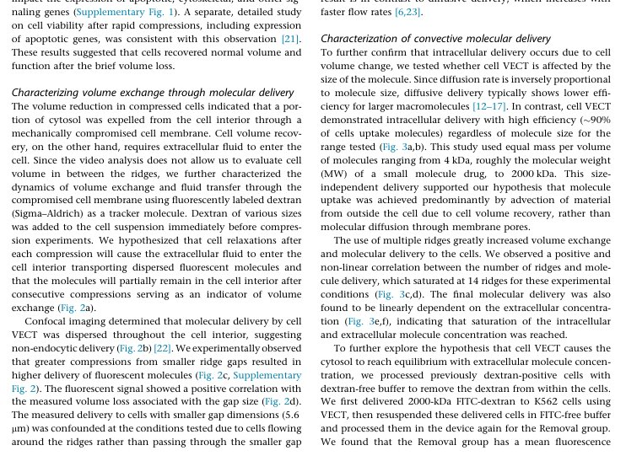
Structuring Content Example
Except from Liu A, Islam M, Stone N, et al. Microfluidic generation of transient cell volume exchange for convectively driven intracellular delivery of large macromolecules. Mater Today (Kidlington). 2018 doi:10.1016/j.mattod.2018.03.002

Slide 37
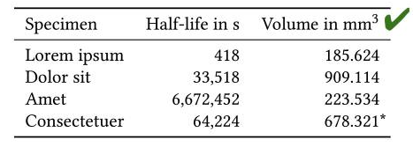
Writing for and about Figures
Writing FOR figures: Figure Caption/Text w/in a figure
Caption: justified/centered text
Bold/italicized figure name (Ex: Figure 1)
Horizontal text only (even for y-axis)
Table units in header for each column (not repeated in every row)
Writing ABOUT figures: Main Text
Directly mention the figure's name that is referenced
Describe the figure in detail after the name is mentioned
Avoid repeating information given in a table/caption
Summarize result and state conclusions and interpretations
Table from Schwen LO. Ten simple rules for typographically appealing scientific texts. PLoS Comput Biol. 2020 doi:10.1371/journal.pcbi.1008458
Except from Liu A, Islam M, Stone N, et al. Microfluidic generation of transient cell volume exchange for convectively driven intracellular delivery of large macromolecules. Mater Today (Kidlington). 2018 doi:10.1016/j.mattod.2018.03.002

Slide 38
Active vs Passive Voice
Active: Subject is performing an action on the direct object (DO)
Emphasis on the subject
Ex: The researcher loaded the samples into the machine.
Passive: Restructure where the DO is the focus
Subject comes after the primary verb or is understood
Ex: The samples were loaded into the machine (by the researcher).
How to choose?
Determine which is more important: Subject or DO?
If the question, "Who?" is important: active voice
Following sentences focus on DO: passive voice

Slide 39
Active vs Passive Voice (cont.)
Passive Voice: Seen as more objective by making agents irrelevant
Disadvantages
Less interesting
Can complicate sentence structure
Readers may want the agent explicitly mentioned in text
Overall Conclusion
Passive voice is best used when the agent has been made clear to the reader in a previous sentence.
Otherwise, active voice is preferable

Slide 40
General Scientific Writing Advice
Be consistent in your word choice
Some words have synonyms w/in a field. Choose one and stick with it!
Ex: Reaction vs Recoil Forces
Different words = Different reader interpretations
Reader may assume something else is happening
Be confident!
Be direct in what you'd like to say
Using discretionary language is reserved for the Discussion section
Ex: "May", "Perhaps", "Probably
Don't antagonize readers
Avoid demeaning words: "clearly", "obviously"

Slide 41
Tools & Resources
Always check relevant journal/government websites for guides
Nature
Formatting guide | Nature
Effective Writing | Learn Science at Scitable
NIH
Sample Applications and Documents | Grants & Funding
Example Research Proposal by the APA
Research Proposal Format Example
Purdue OWL has good advice for writing in general
Purdue OWL® - Purdue OWL® - Purdue University

Slide 42
Questions?
Scan to log attendance
If interested, reach out to Steven Swingle → steven.swingle@gatech.edu​
Find us on Engage https://gatech.campuslabs.com/engage/
Follow us on instagram
@gatech.ric
Research Insights Club

